Slide 1

October 12, 2023
2023 ACA Filing is Around the Corner. Are You Required to:
File This Year? Or
Need a Refresher?
Presentation By:
Joe Aitchison

Slide 2



Before We Begin
?
We are recording today’s webinar
Submit your questions at any time
Please complete the exit survey

Slide 3
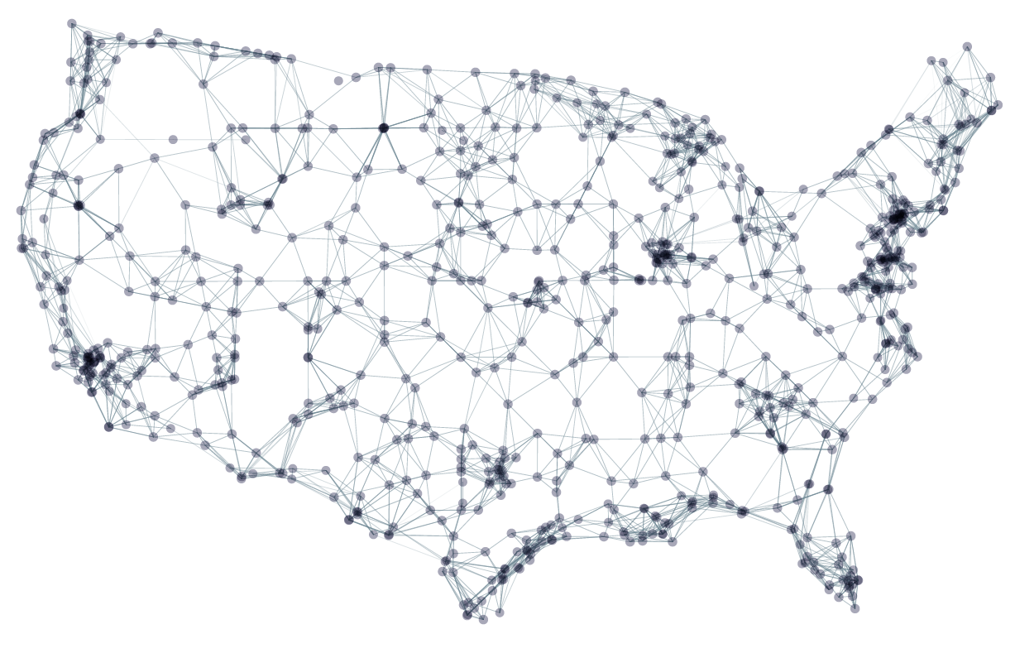

Coast to Coast Administration
BASIC services over
20,000 employers nationwide.

Slide 4
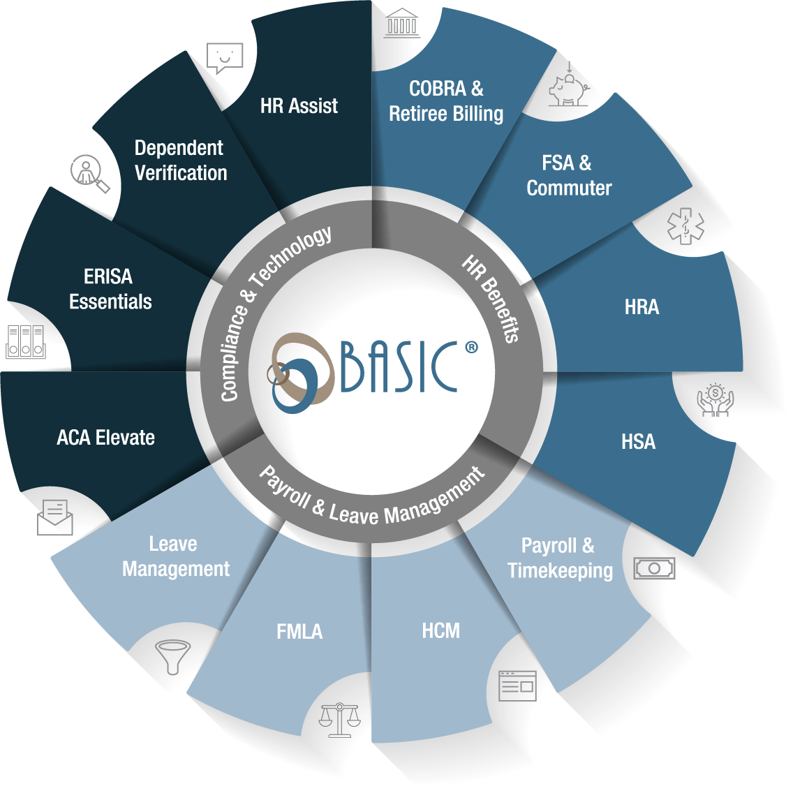
Technology Driven HR Solutions to Take Your Company Further
Suite of HR Benefits, Payroll and Leave Management, and Compliance solutions offered individually or bundled.
HR Solutions should be simple. Keep it BASIC.

Slide 5

Presenter
Joe Aitchison, SPHR, SHRM-SCP, CHRS
Joe provides Business & HR client advisory services and HR out-source services nationally. He is a Human Resource professional with over twenty-five years business management and HR consulting experience. He has worked with multi plant International Tier I Automotive Manufacturing, retail, food processing, health care, legal administration and professional services.
Mr. Aitchison is recognized as a leader in human resources and has obtained a lifetime certification as a senior professional in human resource management, SHRM – Senior Certified Professional and Healthcare Reform Specialist by the Healthcare Reform Center & Policy Institute. Mr. Aitchison serves on several for profit and not for profit boards.

Slide 6
What’s New and What’s Not
2023 Calendar Year Federal Deadline for ACA Form Delivery
1095–B / 1095–C Furnished to all ACA defined full time employees by March 4, 2024
1094 & 1095 IRS Filings by paper (mail) February 28, 2024
April 1, 2024 for electronic filers – E-file Form 1094-C and included 1095-Cs with the IRS
State Filings: Form To EEs State Filing Date
  California January 31, 2024 April 1, 2024 (Historically extends to May 31 with no Penalty applied)
  Washington DC March 4, 2024 April 30, 2024
  Massachusetts January 31, 2024 January 31, 2024
  New Jersey March 4, 2024 April 1, 2024
  Rhode Island March March 4, 2024 April 1, 2024
E-filing requirement changed for the 2023 filing year from 250 1095-C forms filed to employers having
10 or more forms to be filed in 2024 (2023 Tax Year).
Reference: IRS and Treasury issue final regulations on e-file for businesses | Internal Revenue Service

Slide 7
ACA State Filing Reference Information
California
  https://www.calpers.ca.gov/page/employers/policies-and-procedures/aca-guidance
  https://www.ftb.ca.gov/file/business/report-mec-info/index.asp
Washington, DC
  https://otr.cfo.dc.gov/sites/default/files/dc/sites/otr/publication/attachments/FAQ%20reporting%20SRP%20Update.3.31.20.pdf
Massachusetts
  https://www.mass.gov/info-details/health-care-frequently-asked-questions-for-employers#general-questions-
  https://www.mass.gov/service-details/health-care-reform-for-employers
New Jersey
  https://nj.gov/treasury/njhealthinsurancemandate/employers.shtml
Rhode Island
  http://www.ohic.ri.gov/ohic-employers.php

Slide 8
Small Self-Insured Employers
Non-ALE Employers - Having fewer than 50 FTEs
Are not required to provide a 1095-B Form to Employees but must:
  Post on its website that Forms 1095-B are available with contact information to obtain a form
  Employer must provide a form within 30-days from the request
  Employer must file form 1094-B with 1095-B forms with the IRS
ALE Employers (Self-Insured)
Must continue using 1095-C for all full-time employees
No penalty for not issuing 1095-B form to “part-time” employees who are covered under the self-insured health plan
  Notice of 1095-B availability & contact information must be posted on the employer's website
  1095-B provided within 30 days of the request
IRS reporting requirements must be met

Slide 9
Transition Relief – Good Faith No Longer Available
6721 & 6722 “Good Faith Effort” Transition Relief for 2021 and thereafter – No longer available for missing TIN and mismatched Name / SSN on 1095-C Forms.
HOWEVER, the IRS will consider “Reasonable Cause” Penalty Relief for Errors beyond the employer’s control. If the employer receives a penalty notice, the employer needs to provide information to the IRS that the mismatch is beyond their control – not due to the employer’s mistake or neglect (employee provided false or incorrect information).
Review employment records to verify that the SSN is accurate as reported
Contact the employee for correction
Maintain records on verification requests to employee & provide information to the IRS
Other documentation to support errors / omissions were beyond the employer’s control

Slide 10
Affordability Changes
Employers need to confirm that the employee premium portion for self only coverage is affordable.
2023 affordability percentage is 9.12%
2024 affordability percentage is 8.39%
Box “1” of W-2 Wages – (2F)
130 hours x Hourly Rate of Pay (at start of the current plan year) – (2H) “or” lowest pay rate during the month
Federal Poverty - (1A)
  2023 = $103.28
  2024 = 101.93 based on lookback on FPL for 2024 (for Calendar Year Plans)
Reference: Rev. Proc. 2023-9 (irs.gov) issued August 23, 2023

Slide 11
Common Employer Mistakes
Providing affordable coverage that meets minimum essential coverage / minimum value (MEC / MV) to all full-time eligible employees
  Employers often don’t understand how to determine affordable coverage
Manage employees by class of employees
  Who is Full time
  Who is Part time
  Who is a Seasonal Employee?
  Difference between Seasonal “Employee” / Seasonal “Worker”
  Variable Hour Employees
Actively manage employee eligibility for the entire calendar year
Timely offer Affordable MEC/MV Health Benefits to full time employees (working 30 or more hours weekly)

Slide 12
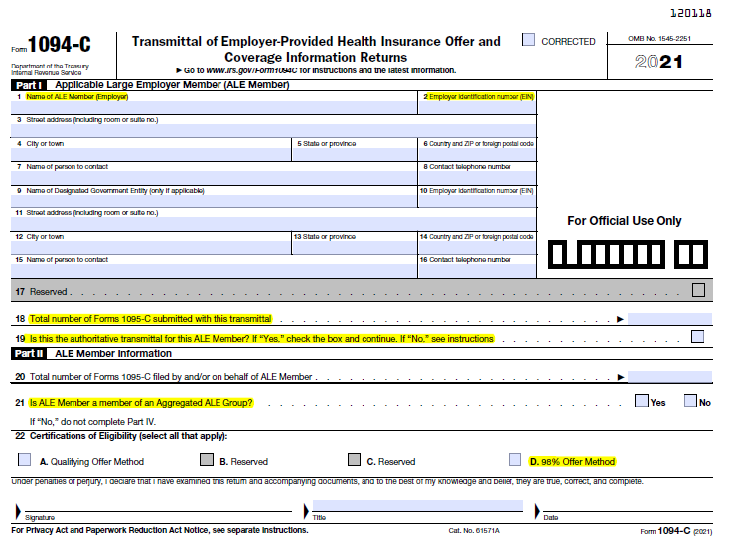
Common Employer Mistakes
Common Employer Mistakes Part I
Employer Information
Don’t use DBA
Part II
Common Mistakes
Check for instructions & forms:
Forms and Pubs Index Search | Internal Revenue Service (irs.gov)
Draft Form

Slide 13
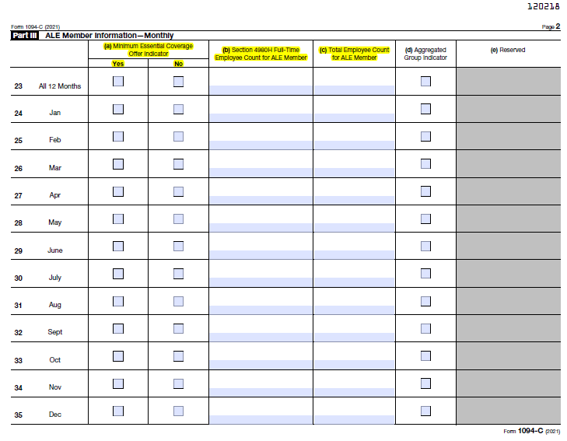
Common Employer Mistakes
Common Employer Mistakes Part III
Employer Information
How to count employees – Why PR records need to be maintained w/ hire & term dates – (Full time / Part time status)
Draft Form

Slide 14
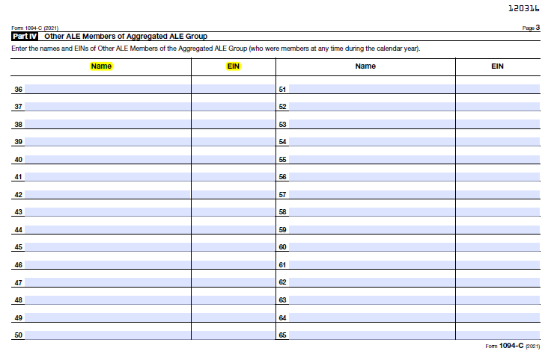
Common Employer Mistakes
Common Employer Mistakes
Part IV ALE Member Information
Common Ownership Rules Apply
  80% Common Ownership
  Includes family members (brother, sister, spouse, parent, etc.)
List ALE with highest number of employees first
List all ALE members
Draft Form

Slide 15
Minimum Value & Minimum Essential Coverage Plan
Minimum Value
An employer-sponsored plan provides minimum value if it covers at least 60% of the total allowed cost of benefits that are expected to be incurred under the plan. (Reference IRS Notice: 2014-69)
Minimum Essential Coverage is the mandatory coverage that employers must offer employees regardless of their health status or plan type to meet ACA requirements. Sometimes referred to as Essential Health Benefits (EHBs).
ACA qualifying Health Plans must include the following 10 essential benefits:
Laboratory services
Emergency services
Prescription drugs
Mental health/substance abuse
Maternity and newborn care
Pediatrics services, including oral and vision care
Rehabilitative and habilitative services and devices
Ambulatory patient services
Preventive/wellness services and chronic disease management
Hospitalization
Note: Not sure if your plan meets MEC / MV to Employees & Dependents… Check your Summary of Benefits & Coverage (SBC)

Slide 16
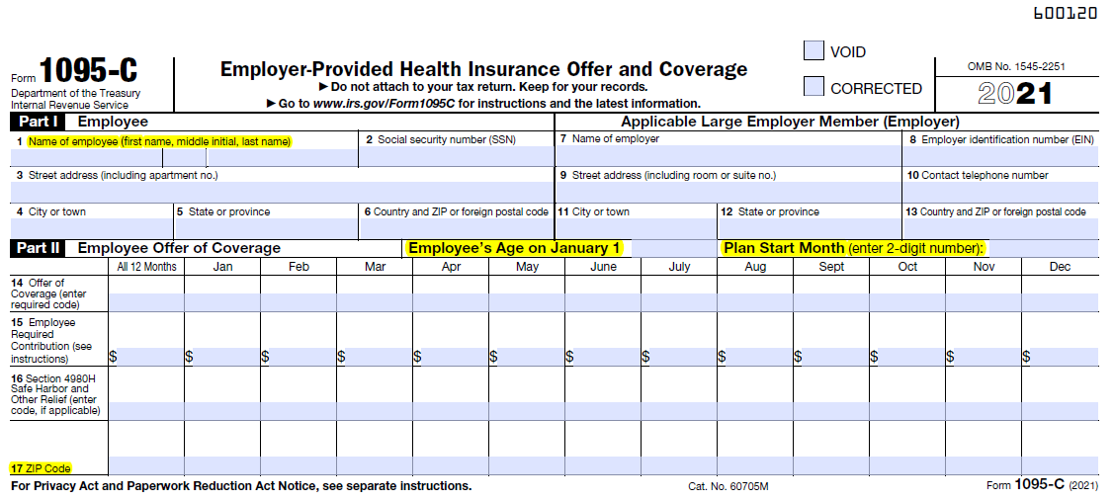
Common Employer Mistakes
Common Employer Mistakes
Employee Information
Not using Employee’s Formal Name
Line 14 Common Miscoding
Line 15 Common Mistakes
Line 16 Common Miscoding
Draft Form

Slide 17
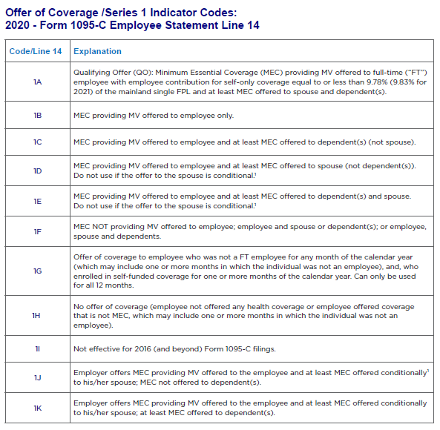
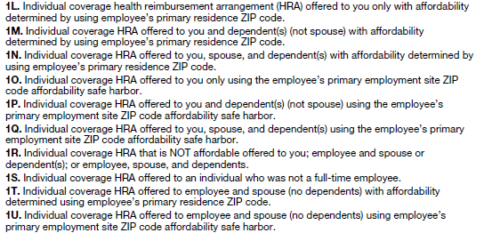
ACA 1095-C Current Codes
Offer of Coverage Indicator Code (same as 2022)
Line 14 – 1095-C
Individual HRA ACA Affordability Determination
ICHRA affordability is important – affects the employee ability to obtain a tax credit on the exchange - unaffordable subjects the employer to a 4980H tax penalty.
If an ICHRA is “affordable”, employees are not eligible for tax credits (PTC)
If an ICHRA is “unaffordable”, employees can choose either the ICHRA or tax credits (PTC)
Safe harbors to determine household income?

Slide 18
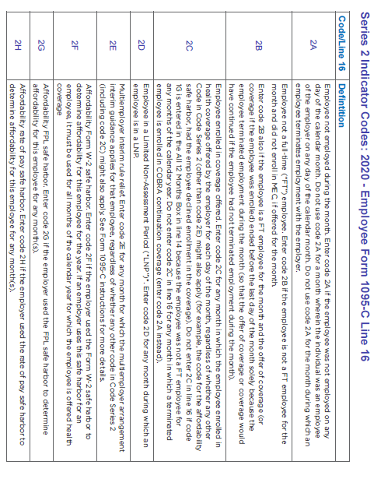
1095-C Line 16 Codes
Line 16 Indicator Code (same as 2022)

Slide 19
ALE Determination / FTE Count
ALE - FTE Calculation
An employee with 130 or more hours per month is considered FT for the month for purposes of determining whether an offer of coverage is required.
An employee with 120 hours or more per month is considered FT for the month for purposes of determining ALE status.
The hours of all employees with less than 120 hours per month are added and then divided by 120 to determine the total FTEs for purposes of determining ALE status.
ALE Calculation
Add each month’s total FT and FTE counts for all 12 months in the preceding tax year and divide by 12. Round down to get your ALE status.
If the result is 50FT/FTE or greater, then you are an ALE.

Slide 20
The Payroll Challenges
Maintain current employee addresses on file
Understand that the SSN verification system for ACA reporting is “not the same” as it is for Payroll (more restrictive – less forgiving)
  Employee Name
    As it appears on the SS Card should be used for payroll purposes (potential rejection, especially for foreign nationals)
Maintain “accurate” Hire & Termination Dates as part of EE payroll record
  Inactive employee status does not transition over to ACA filing
Maintain Employee Status Information Uniformly
  Full time / Part time / Seasonal Worker / Seasonal Employee / Variable Hour Employee
  Change employee status as applicable on payroll records – by date of event
Uniformly cross reference job titles with Employee Status or Classes:
    Examples: Manager FT / Manager PT; Hourly. Maintenance FT or PT
    Define part time as less than 30 hours weekly

Slide 21
From the Employer Side
So, an employee goes to the Exchange – What happens next?
IRS is reviewing / auditing past employer filings
  Started in 2016 and now reviewing 2020 filings
  Issuing penalties for no filing & failing to provide 1095-C forms to employees for 2020
  2023 – will continue reviewing 2020 filings and soon start on 2021 filings / failing to file.
  If captured during an IRS internal review – inaccuracies in employer 1094-C may trigger a review of the State Exchange Data files (for employees who opted for health benefits from the exchange and received a subsidy)
Employees who went to the exchange and received a subsidy and indicated the employer did not make them an affordable offer of coverage
  Was the employee full time or part time?
Did the employer file a 1094-C w/ 1095-C forms?
  If FT, then there is a possibility the employer will receive an IRS penalty notice
  So how does the IRS know if I was supposed to file a 1094-C or not?
    Employer federal business tax records and state payroll records are clear indicators on the “estimated” number of employees working for an employer. IRS will review the W-3 report filed by the employer to determine W-2 count for penalty purposes if no 1094-C was filed with the IRS.
    Information reported by Fed//State Exchanges – who obtained coverage from the exchange and received a subsidy

Slide 22

Employer Shared Responsibility Payment (ESRP)
ESRP Notices | ACA
What happens if...
In a 2018 report the Treasury Inspector General for Tax Administration (TIGTA) commented that the IRS uses the Affordable Care Act Compliance Validation (ACV) system to automatically identify non-compliant ALEs.

Slide 23
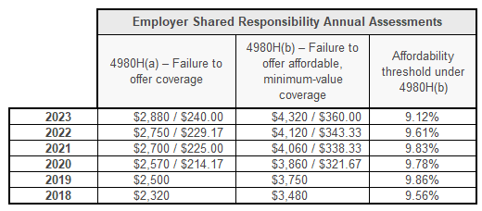
Employer Shared Responsibility Provisions
ALEs must:
Liability exists if employer (ALE):
Offer Affordable Minimum Essential Coverage (MEC) health coverage providing value to their full-time (FT) employees and at least Minimum Essential Coverage to their dependents
OR
Potentially be subject to an employer shared responsibility payment
(a) Penalty: Employer does not offer coverage to at least 95% of FT employees (and their dependents) and at least one FT employee receives a premium tax credit (PTC) $229.17 (M) / 2,2750 (A) Xs all FTE ~ 2023 Rate
or
(b) Penalty: Employer does offer to 95% of FT employees (and their dependents), but at least one FT employee receives a PTC from the Marketplace (Exchange) – 2023 (b) amount ~ $343.33 (M) /$ 4,120 (A) per EE that receives a subsidy form the Exchange
Reason for an individual PTC:
not offered
unaffordable, or
did not provide minimum value

Slide 24
IRS Enforcement of Pay or Play Penalty – Letter 226J
In most cases, the employers who are receiving the notices* appear to have inaccurately completed their IRS Form 1094-C regarding whether or not the employer offered coverage to an individual employee or at least 95% of its full-time employees
* Initial tax penalty notices sent to employers are “inquiries” and not an actual penalty

Slide 25
IRS Enforcement of Pay or Play Penalty – Letter 226J
The IRS notice will list one or more employees who went to the exchange and received a premium tax credit, triggering the penalty (Form 14765 received with 226J Letter)
If the “a” penalty does not apply, the employer can still be subject to the “b” penalty for each full-time employee who was not offered affordable, minimum value coverage and who received a premium tax credit

Slide 26
ESRP Assessment and Payment
IRS will send the Employer an inquiry notice
IRS will check to see if the Employer filed a 1094-C Form for that year (most likely 2020)
A 226J Letter – Notice w/ “Proposed” penalty amount will be sent to the employer
  Employer has 30 days to respond (can be extended an additional 30 days)
Form 14764 – Opportunity to agree, reduce penalty or state no penalty due & to identify an authorized representative to contact IRS
  Optional – Form 2848 POA (can be used but not necessary to respond to the 226J Notice)
Form 14765 – Lists Employees who went to the exchange & received a subsidy
Note: If Employer fails to respond to the 226J Letter / Notice the IRS will
Send a reminder notice allowing 15 days to respond
Assess the (a) or (b) penalty – based on the information provided on the filed 1094-C form

Slide 27
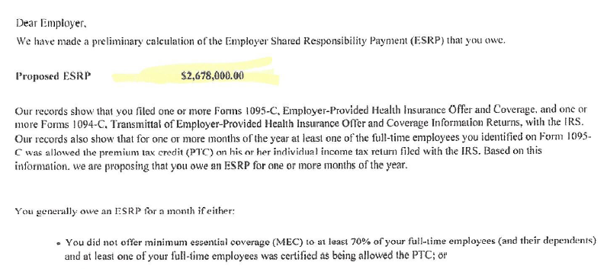
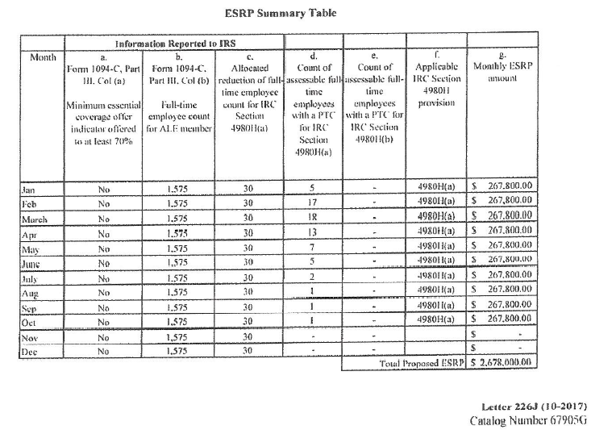

ESRP Assessment and Payment

Slide 28
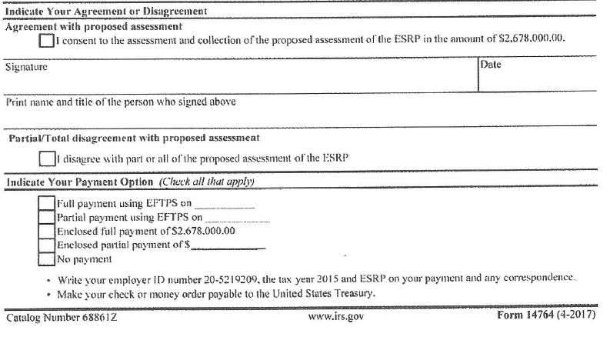
ESRP Assessment and Payment

Slide 29
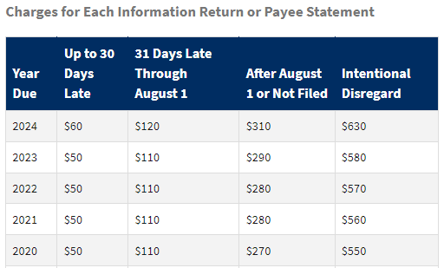
5699 Letter - Reporting Penalties
  IRS can assess $290 penalty per return (TY-2023) for late, incomplete or incorrect forms
  IRS can assess another $290 penalty (TY-2023) for failure to provide a 1095 form to employees
  IRS granted relief for incomplete or incorrect returns for prior years if good faith effort
  2020 filing was the final year for Good Faith Relief
  HOWEVER, Relief is available for good Cause (reasons) for errors or failed filings.
Penalty Relief guidance
Penalty Relief due to First Time Abate or Other Administrative Waiver | Internal Revenue Service
Information Return Penalties | Internal Revenue Service (irs.gov)

Slide 30
IRS 5699 Letter / 5698 Follow-up Letter
What happens if I did not file a 1094-C in past years (2017, 2018, 2019 , 2020, and now 2021)
Am I in IRS Trouble? Answer: Maybe yes / maybe no …
IRS is reviewing employer W-3s – based on number of W-2 issued to determine if there should be a 1094-C on file for that employer for the year.
OR
An employee went to the exchange and obtained coverage and possibly a subsidy, telling the exchange that you (the employer) did not offer them affordable health benefits.
The IRS is checking individuals who went to an exchange and received a subsidy – back checking their employer filings to determine if a 1094-C was filed for that year.
What happens next: IRS 4980H Unit issues a 5699 “Inquiry” letter to the Employer – if the employer does not respond to the 5699 letter, a follow up IRS letter (5698) will be sent. If the employer fails to respond to this letter a 5005A Letter will be sent to the employer (failure to file/ failure to provide EE with 1095-C form.
If the employer files late (Mandated Deadlines) the IRS can issue a 972CG Penalty Notice

Slide 31
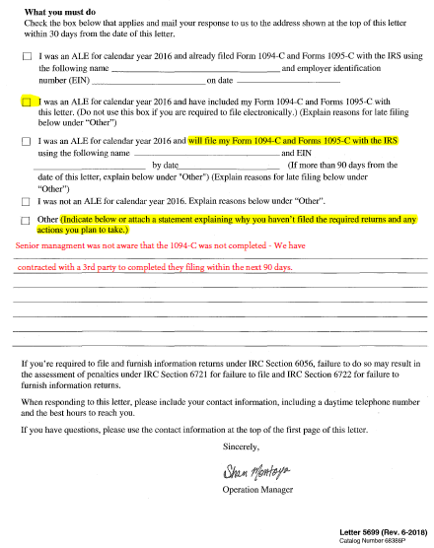
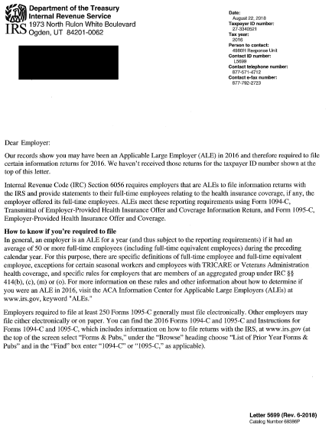
IRS 5699 Letter

Slide 32
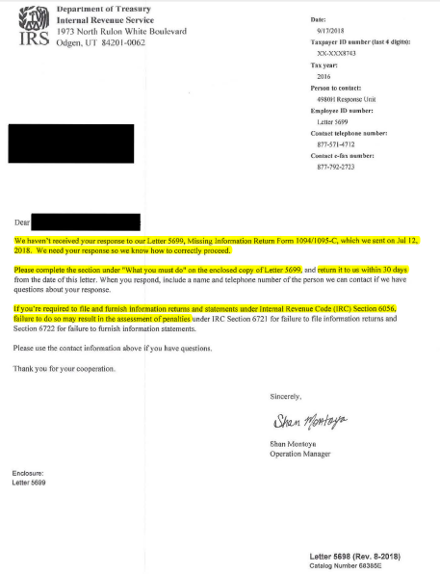
5698 IRS Follow-up
Letter

Slide 33
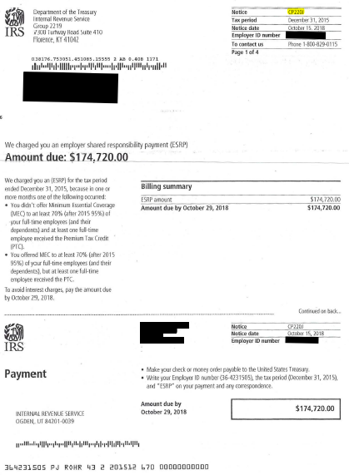
CP220J IRS Penalty
Notice

Slide 34


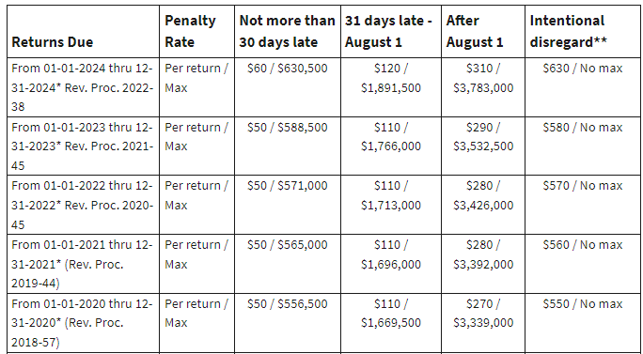
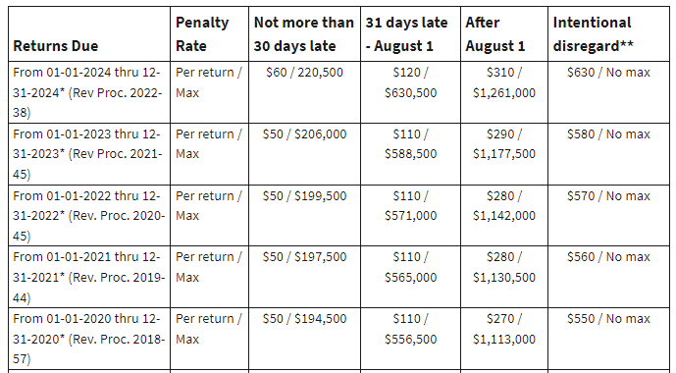
Penalty Rates
Reference: (IRP) Notice: 20.1.7 Information Return Penalties | Internal Revenue Service (irs.gov)

Slide 35


Before Q&A
HRCI/SHRM certificate is in the handout section
Receive an email tomorrow with
the certificate & recording
Please complete the exit survey

Slide 36

QUESTIONS

Slide 37
BASIC’s ACA Solution

Slide 38

Reporting For Any Employer!
Self-insured and fully-insured
Renewing benefits mid-year
Multiple companies filing as a controlled group
Union and non-union environments
Age banded
BASIC can handle them all!

Slide 39

Why ACA Elevate?
Straightforward 2-part process
Correct coding done for you!
Video training/PDF tutorials
Excellent customer and compliance support guiding you through the process
BASIC assumes liability for accuracy of the transmittal to the IRS, timing of the employee forms, and accuracy of the information
  Of course, we can't be held responsible for the data that you or your carrier provide but if we make the error, then we will make it right

Slide 40
ACA Elevate: The Process
  Employer Information
  Employee Classifications
  Employee Census
  Dependent Census
  (if self funded)
  1094/95C to PDF
  Generates eFiling format
  Summary report
Input
Upload
Generate Reports

Slide 41
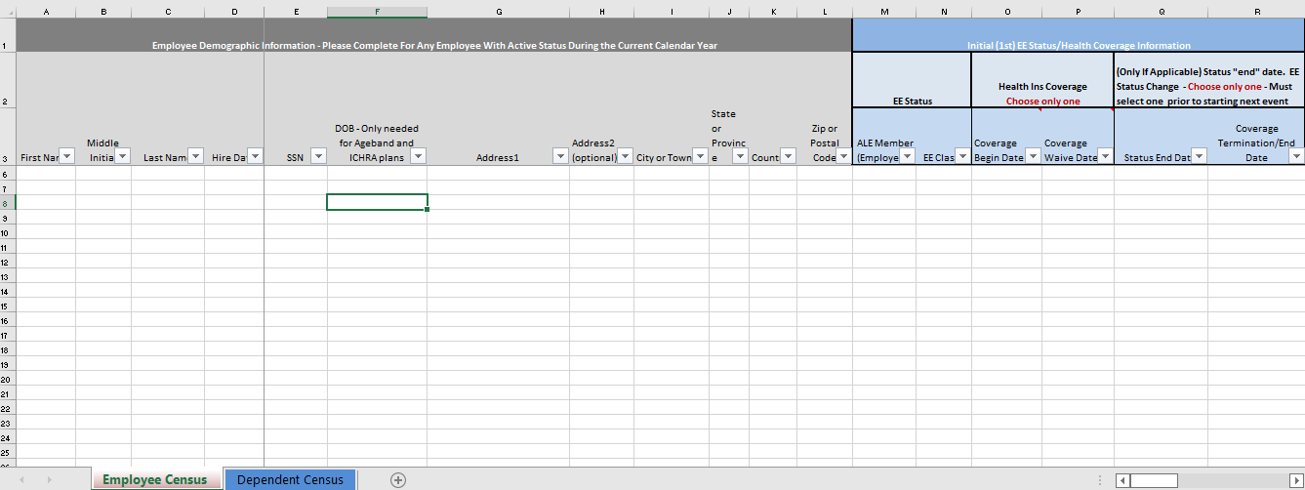
ACA Workbook

Slide 42
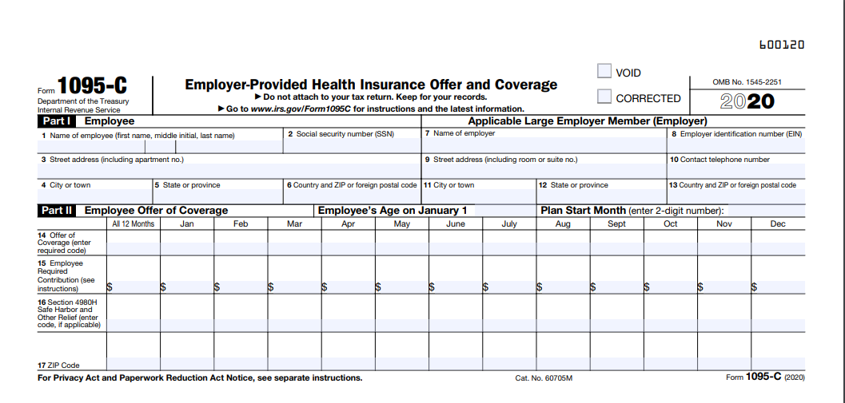
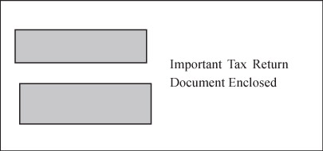
ACA Elevate – Mail Option*
Print and mail to employees’ homes
*Additional cost

Slide 43
Request a Proposal
For you or your client at this link:
https://www.basiconline.com/request-a-proposal/
BASIC Sales
888-602-2742
HR Solutions should be simple. Keep it BASIC.

Slide 44
THANK YOU
View our current webinar schedule at
www.basiconline.com/webinar.

Slide 45
Disclaimer
This presentation is designed to provide accurate information in regard to the subject matter covered. It is provided with the understanding that BASIC is not engaged in rendering legal or other professional services. If legal advice or other expert assistance is required, the services of a competent attorney or other professional person should be sought. Due to the numerous factual issues which arise in any human resource or employment question, each specific matter should be discussed with your attorney.

